Slide 1

DevOps
Session 1

Slide 2
DevOps
DevOps is a practice not a technology.
DevOps is the union of people, process, and technology to continually provide value to customers.

Slide 3

What is DevOps?
A compound of development (Dev) and operations (Ops), DevOps is the union of people, process, and technology to continually provide value to customers.
DevOps Model Defined
DevOps is the combination of cultural philosophies, practices, and tools that increases an organization’s ability to deliver applications and services at high velocity: evolving and improving products at a faster pace than organizations using traditional software development and infrastructure management processes.
This speed enables organizations to better serve their customers and compete more effectively in the market.

Slide 4
How DevOps Works
Under a DevOps model, development and operations teams are no longer “siloed.” Sometimes, these two teams are merged into a single team where the engineers work across the entire application lifecycle, from development and test to deployment to operations, and develop a range of skills not limited to a single function.
These teams use practices to automate processes that historically have been manual and slow. They use a technology stack and tooling which help them operate and evolve applications quickly and reliably. These tools also help engineers independently accomplish tasks (for example, deploying code or provisioning infrastructure) that normally would have required help from other teams, and this further increases a team’s velocity.

Slide 5
Who is a DevOps Engineer?
DevOps Engineer is somebody who understands the Software Development Lifecycle and has the outright understanding of various automation tools for developing digital pipelines (CI/ CD pipelines).
DevOps Engineer works with developers and the IT staff to oversee the code releases.
They are either developers who get interested in deployment and network operations or sysadmins who have a passion for scripting and coding and move into the development side where they can improve the planning of test and deployment.

Slide 6

What was used before DevOps ?
When DevOps comes ?
Why DevOps comes ?

Slide 7
What was used before DevOps ?
Some software development method was followed from 1957 to 1990’s, but in the late 1976 it was named as Waterfall model.
Due to the frustration of this traditional method, several software development teams began to change their approach to planning and delivering new products throughout the 1990s.
During this time (1990-2000), several development methods introduced like Scrum, Rapid Application Development, Extreme Programming, DSDM, Feature-Driven Development and Pragmatic Programming. While these methods vary, the common thread among all of them is a lighter-weight model that allows for more flexibility and less overhead planning. These approaches to software development are the earliest methods in the history of Agile.

Slide 8
When DevOps comes ?
Finally in the early 2000’s, Agile was proposed. While Agile took off in the early 2000s, the Agile Manifesto pick up new steam in the 2010s, but between 2012 and 2015, real life success metrics began to accompany that story.
The DevOps philosophy is not completely new, it has naturally evolved from the Agile methodology. The two have many similarities, which is why they’re not mutually exclusive.
DevOps concept was discussed in 2009 and introduced in 2012 and it took off from 2014.
1967
2009
2017
DevOps introduced
very famous
ARPANET
1957
2003
2012
First computer program
was written
Google
DevOps started boom

Slide 9
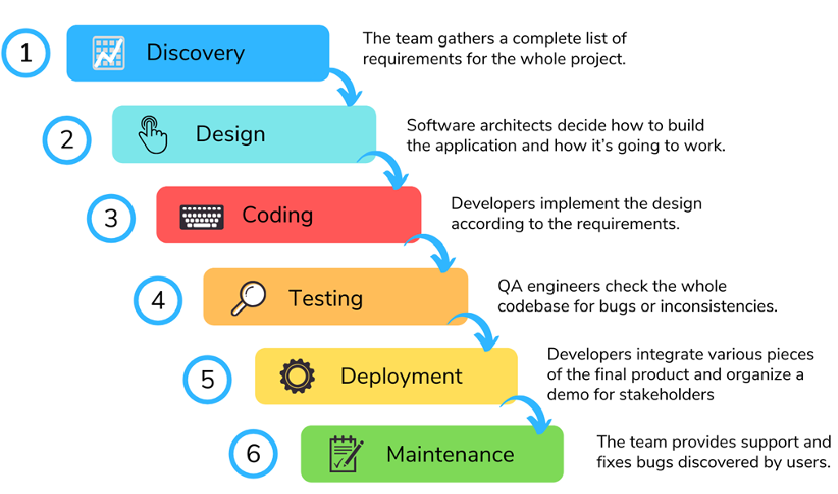
Waterfall Model / Methodology

Slide 10
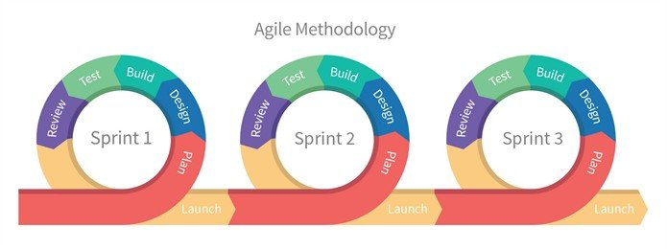
Agile Methodology
Agile is a process used to manage complex projects.
DevOps follows an agile methodology that is used to implement continuous integration and delivery.

Slide 11
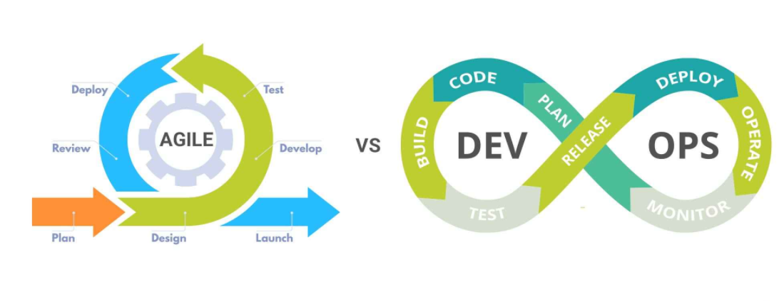
DevOps
While Agile is a process used to manage complex projects. DevOps is the concept to manage end-to-end engineering processes.

Slide 12
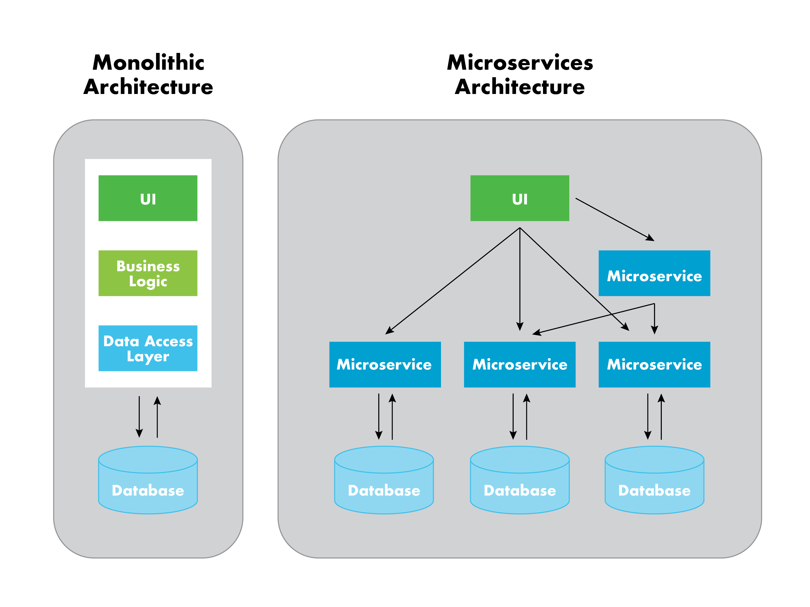
Why DevOps comes ?
Answer : During/After the Architectural transition.

Slide 13


